Slide 1

Otherwise Result Will be

Slide 2
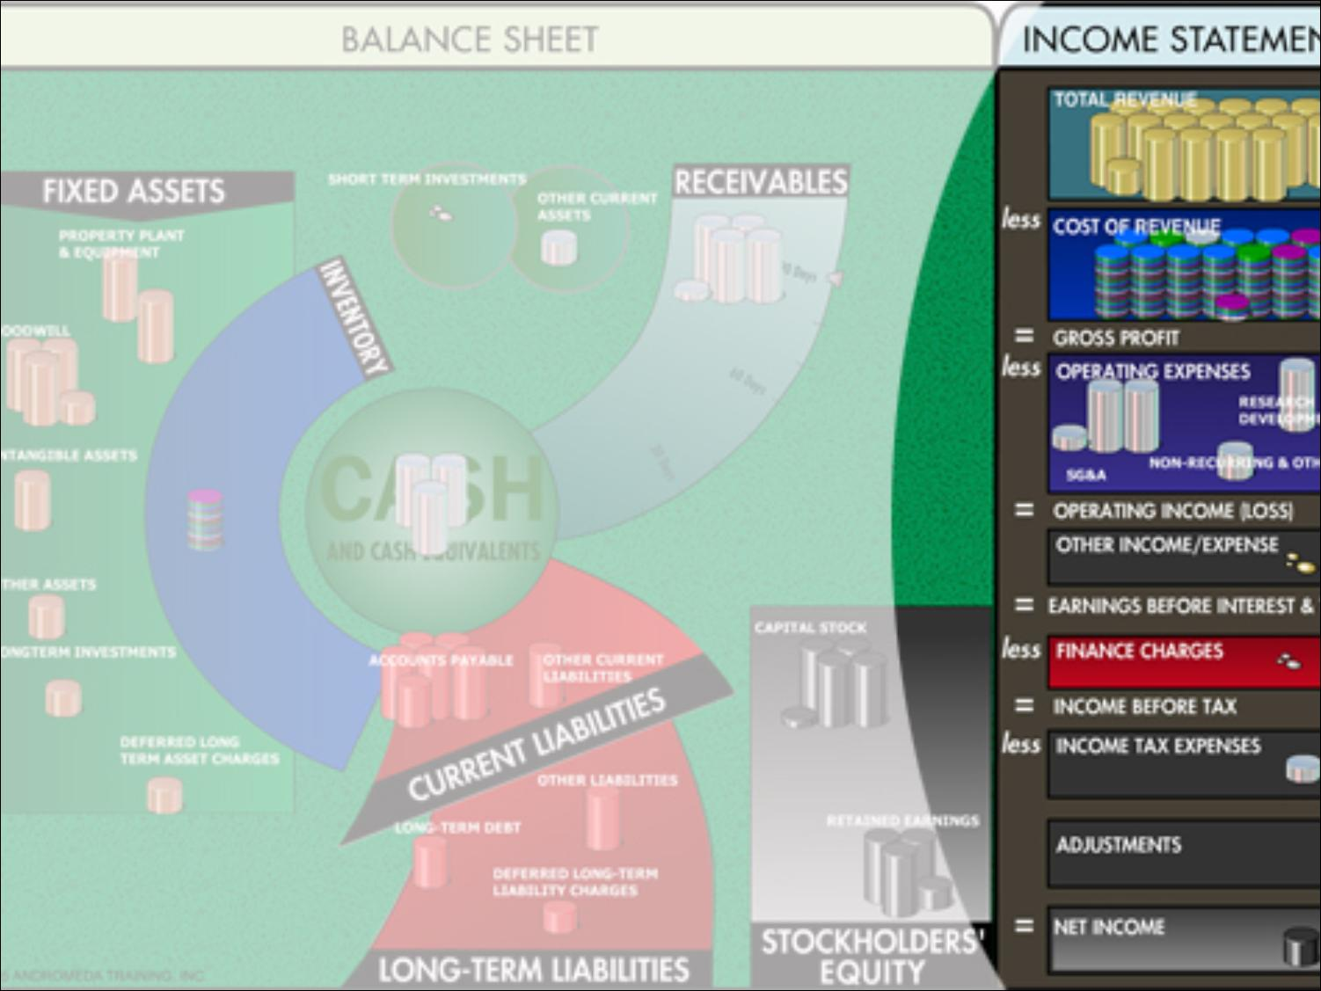
Financial Overlook
2007 2008
Total Revenue 39.579 M 90.066 M
Gross Profit 6.362 M 16% 7.979 M 9%
Pre-tax Profit
Margin 97,275 2.46% 2.049 M 2.3%
Net Income 77,820 0.2% 1.639 M 1.82%

Slide 3

Financial Overlook
2007 2008
Return on Assets 0.31% 6.0%
Return on Equity 0.31% 6.45%
Profit on Sales 0.2% 1.82%
Profit to Total
Liabilities 57.34% 80.22%
Solvency Ratio 0.54% 33%
Turnover 157% 328%
Growth Rate

Slide 4
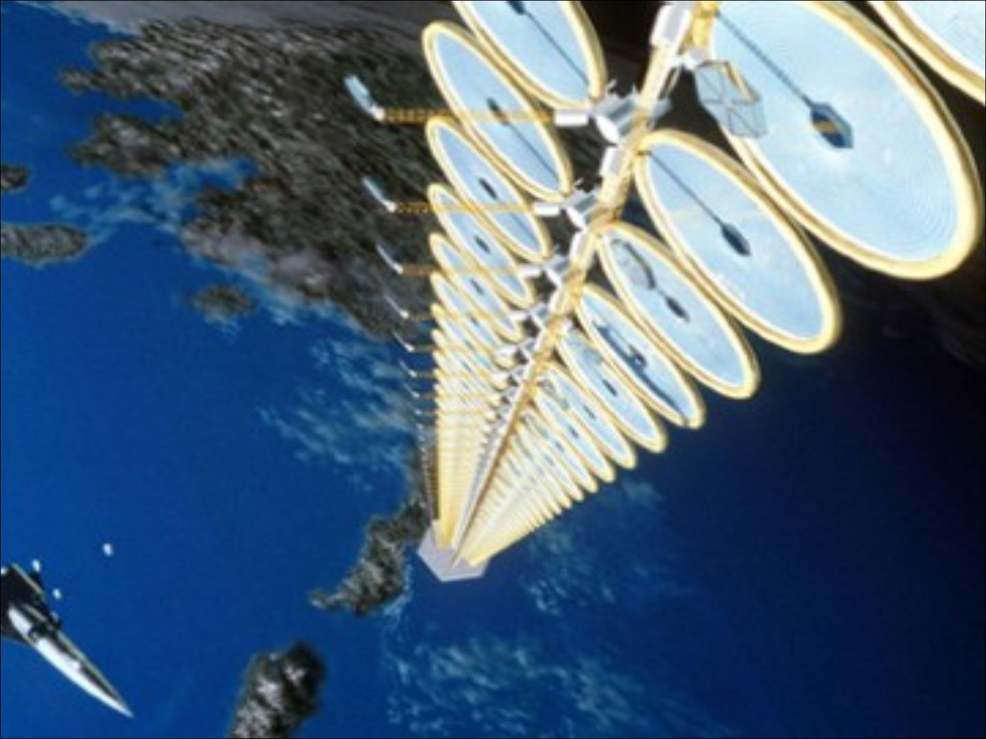
Future Outlook
    Multinational Petrol Pumps
    Large Plazas
    Other Big Cities

